Slide 1
DNA Alignment and Variant Detection
BIOCHEM 3BP3

Slide 2
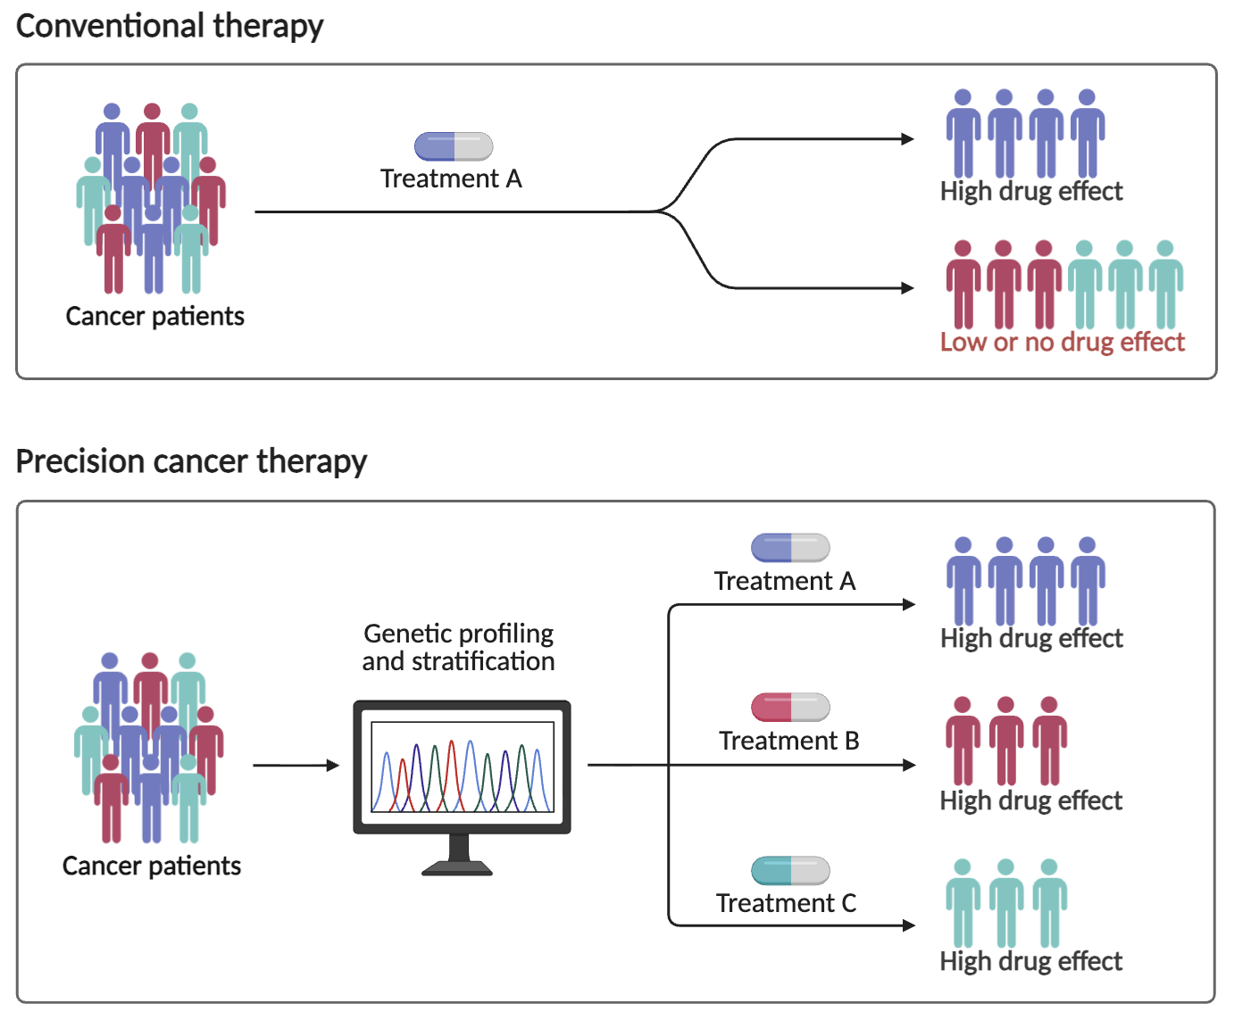
Motivation: personalized oncology
KRAS mutation
KRAS inhibitor
EGFR mutation
EGFR inhibitor
BRAF mutation
BRAF inhibitor
Biorender

Slide 3
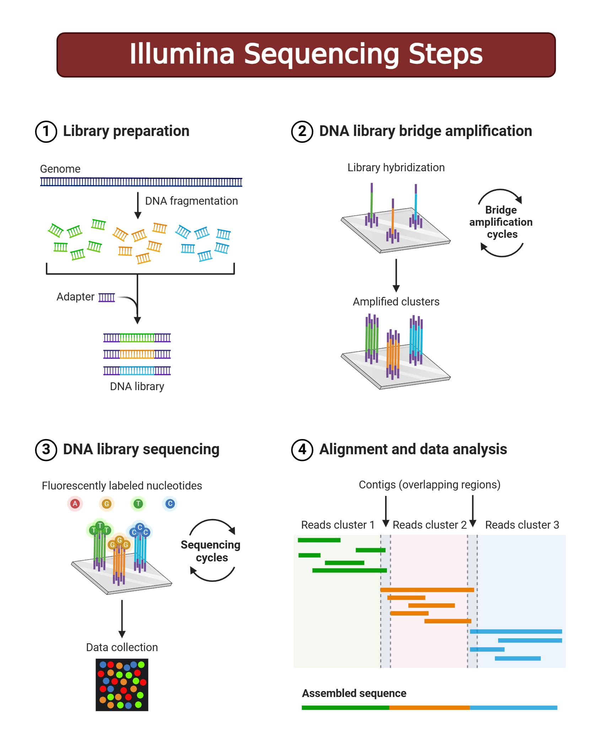
DNA sequencing: Illumina (short read sequencing)
DNA sequencing has an error rate, so a single pass is insufficient
Reads are ~250 bp before chemistry breaks down
https://microbenotes.com/illumina-sequencing/

Slide 4
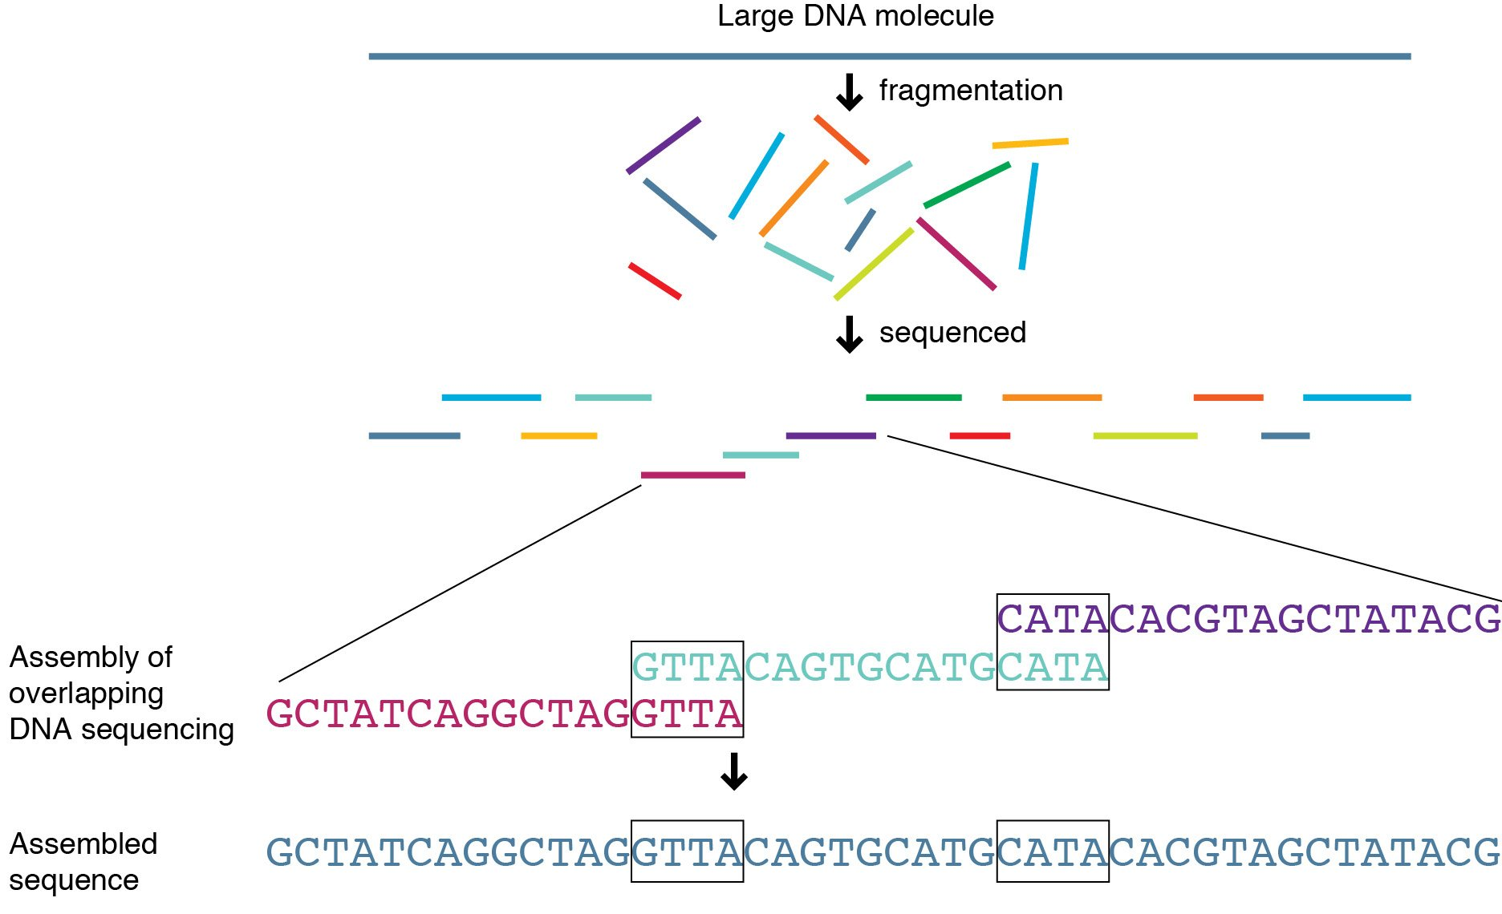
Genome assembly by overlap
http://knowgenetics.org

Slide 5
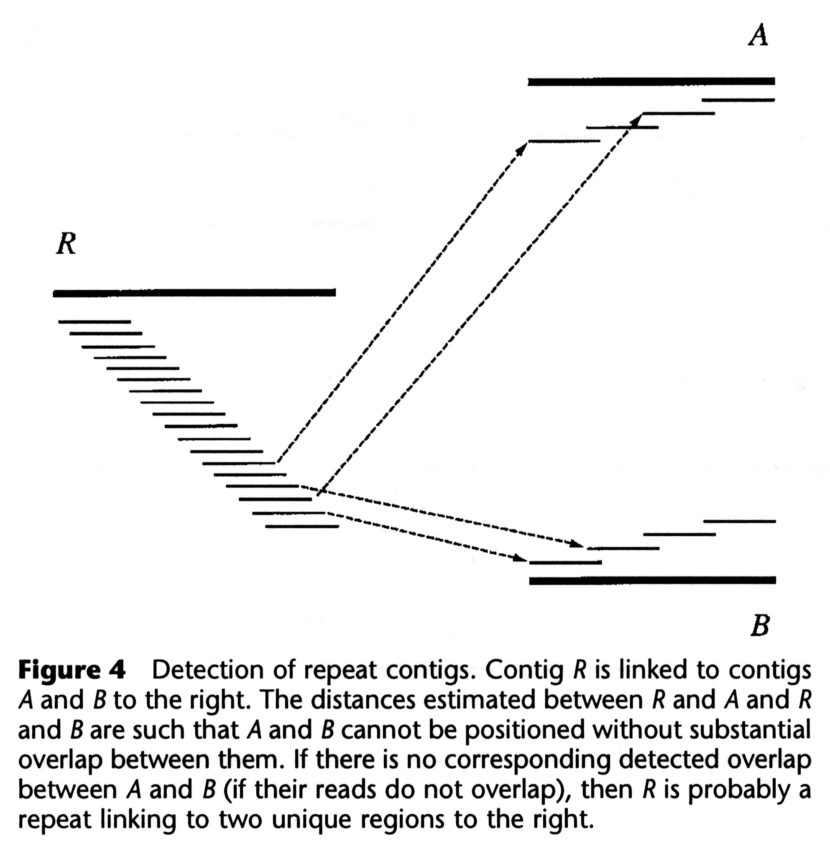
Problem with greedy assembly: Repeats
Greedy algorithms merge reads into consensus ‘contig’ sequences
What if reads are similar but from different parts of the genome?
Greedy algorithms are insufficient to handle this problem

Slide 6
Bi-directional sequence (aka Mate Pairs)
250 bp read (R1)
250 bp read (R2)
1500 bp fragment
R1 and R2 are mate pairs where we know the orientation to each other and the distance between them
Geometry constrains the assembly algorithm

Slide 7
Genome assembly by overlap
http://knowgenetics.org

Slide 8
Genome assembly by overlap
The human genome is 3 billion base pairs!
http://knowgenetics.org

Slide 9
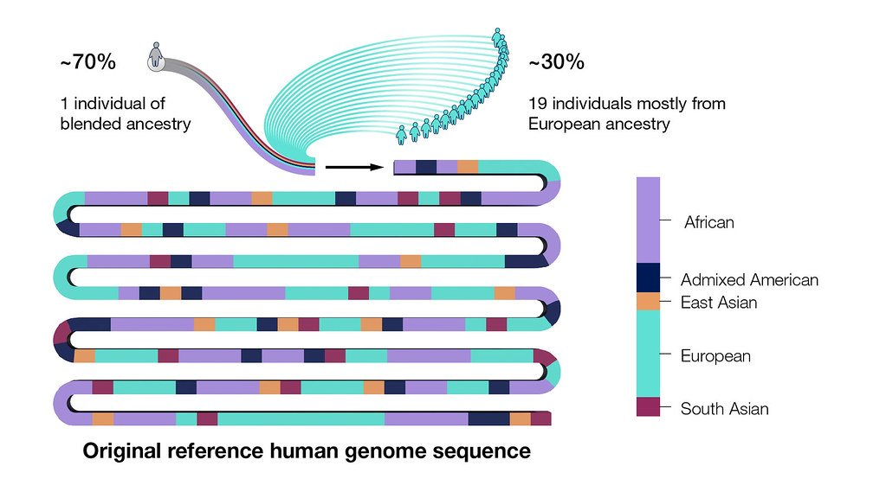
The Human Genome: a single “average” reference
The Human Genome Project (1990-2003)
Original sequence covered 90% and came from 20 volunteers
GRCh38 (2013)
Covered up to 92% of total genome
  Gaps primarily in centromeres & telomeres
Telomere-to-telomere (T2T) (2022)
T2T Consortium released first gapless human genome

Slide 10
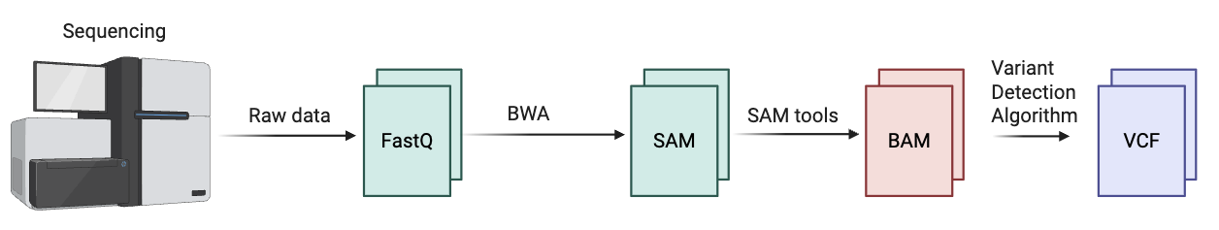
DNA Alignment Pipeline

Slide 11
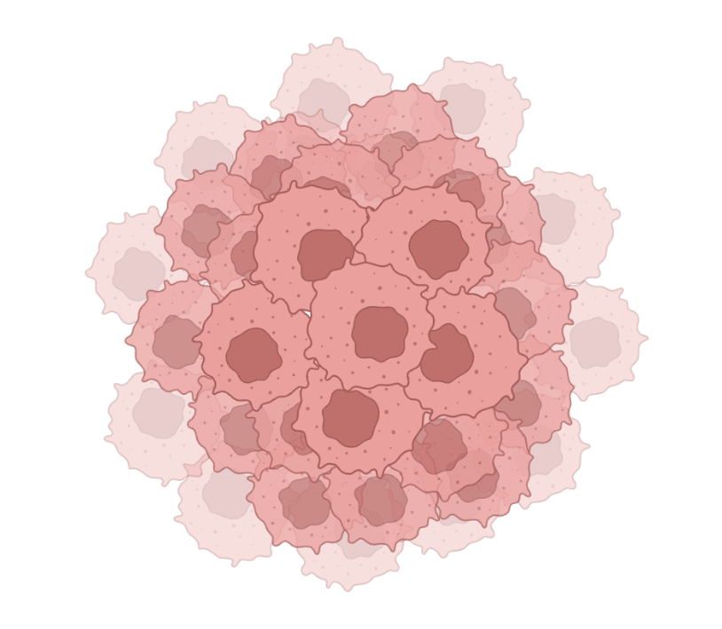

DNA Alignment Pipeline
With bulk sequencing, read out is an average of all cells that were sampled.

Slide 12
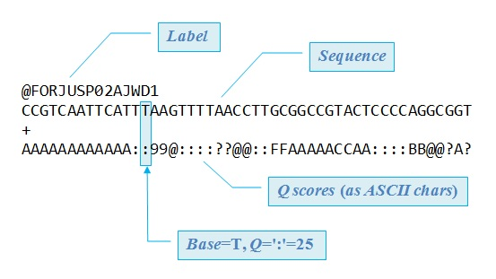
DNA Alignment Pipeline

Slide 13
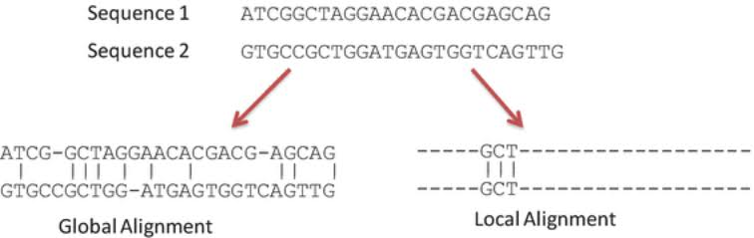
Local vs global alignment
A local alignment algorithm doesn't ask "what's the best way to line up these two sequences from start to finish?" It asks: "what is the highest-scoring alignment between any substring of sequence A and any substring of sequence B?" Regions with no meaningful similarity simply don't participate

Slide 14
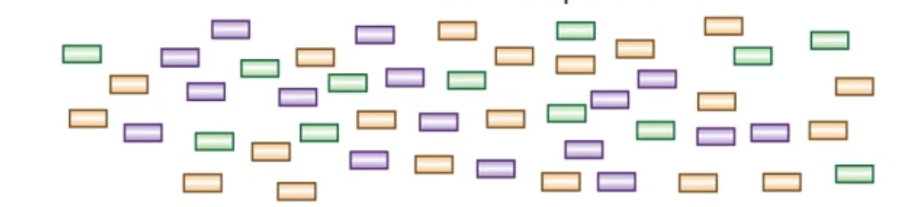
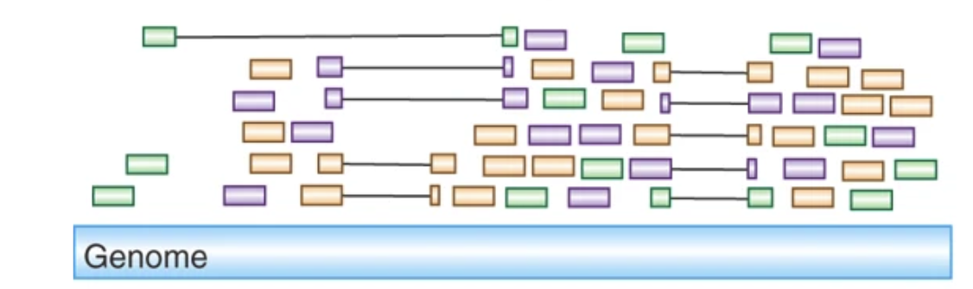
DNA alignment using a reference genome: Semi-global alignment
Read mapping is considered semi-global
Mapping entirety of the read (global alignment) to a local region of the genome (local alignment)
Map reads to reference genome
Haas and Zody, Nature Biotech 2010

Slide 15
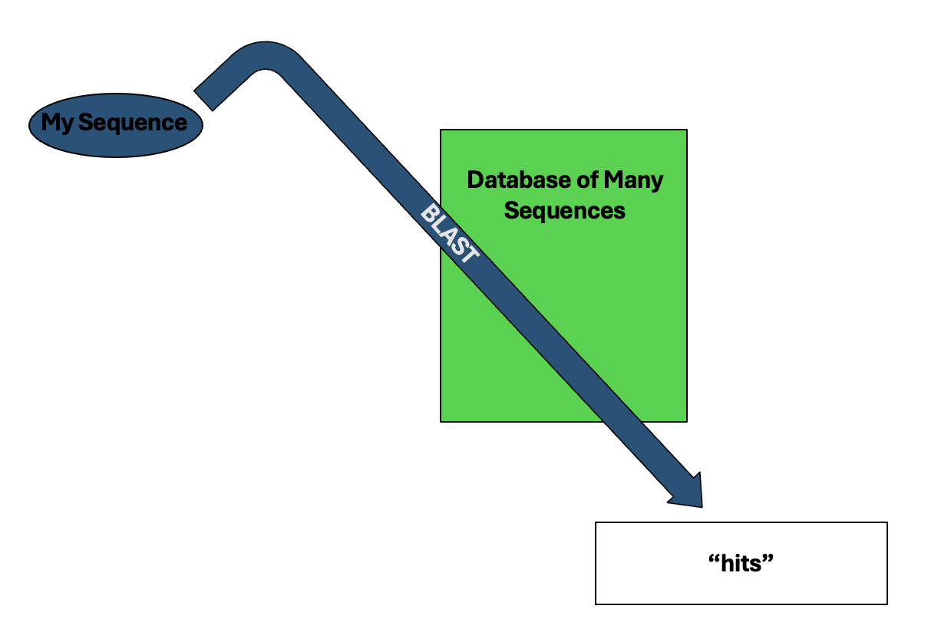
Basic Local Alignment Search Tool (BLAST)

Slide 16
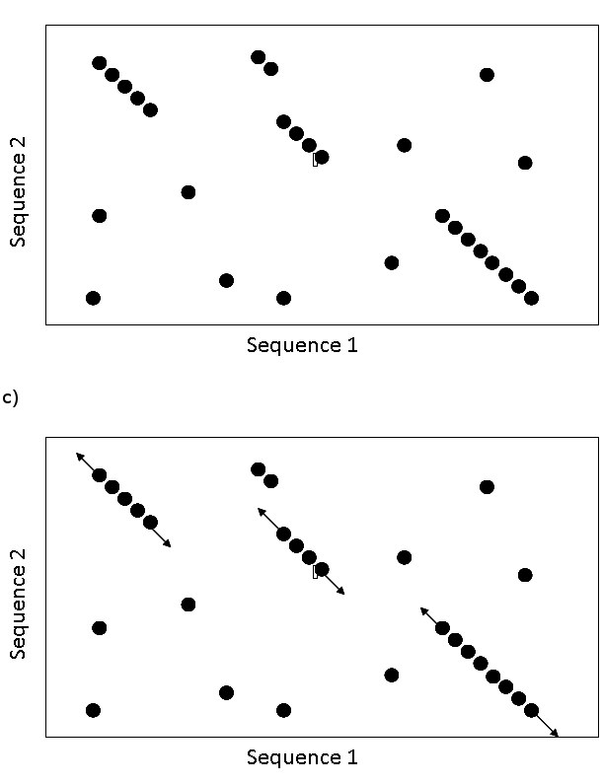
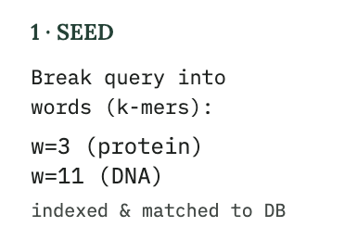
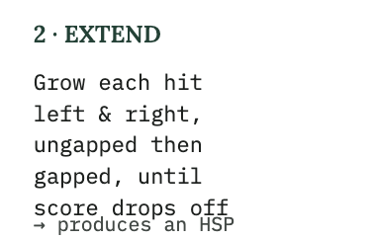
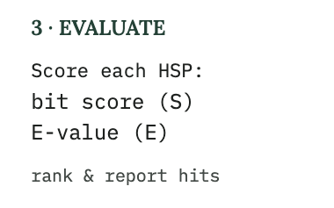
Basic Local Alignment Search Tool (BLAST)
High Scoring Pair (HSP)

Slide 17
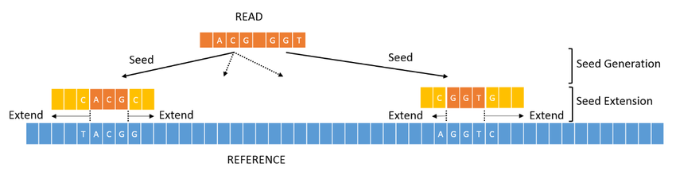
DNA alignment using a reference genome: BWA MEM
Conceptually similar to BLAST
Uses kmer seeds to identify regions of similarity and then extends from those seeds
During extension process, BWA MEM uses Smith-Waterman style alignment which allows it to handle mismatches and gaps (insertions/deletions)

Slide 18
Bi-directional sequence (aka Mate Pairs)
250 bp read (R1)
250 bp read (R2)
1500 bp fragment
R1 and R2 are mate pairs where we know the orientation to each other and the distance between them
Geometry constrains the assembly algorithm

Slide 19
Also need to optimize for correct read geometry
250 bp read (R1)
When mapped, mate pairs should map in opposite orientation with the expected inner distance
250 bp read (R2)
1500 bp fragment
~1000 bp inner distance
250 bp read (R1)
250 bp read (R2)

Slide 20
DNA alignment using a reference genome: BWA MEM
Step 0: BWA converts reference genome into compressed index file first
Index generated through Burrows-Wheeler Transform
BWA Index
Seeds
Seeds are mapped against compressed index file (rather than linear sequence string) which dramatically speeds up the process

Slide 21
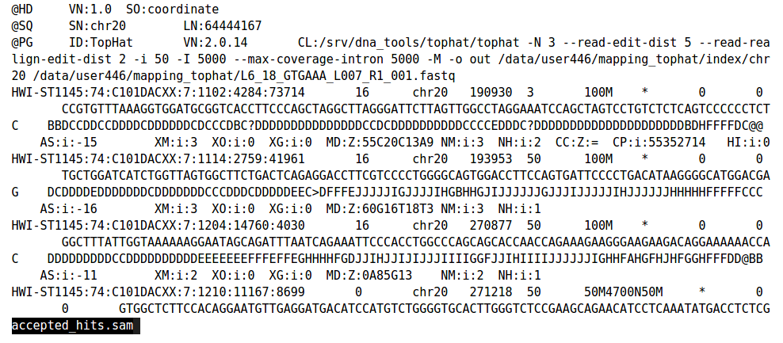
DNA Alignment Pipeline
Genomic coordinates
SAM file
Mapping quality
CIGAR

Slide 22
DNA Alignment Pipeline
SAM file
Compressed binary version of a SAM file

Slide 23
Motivation: personalized oncology
KRAS mutation
KRAS inhibitor
EGFR mutation
EGFR inhibitor
BRAF mutation
BRAF inhibitor
Biorender

Slide 24
Single nucleotide variants (SNV)
Definition: Change of a single base pair change
Reference Genome
A T C G C A G
Example Sequence
A T C G C C G
Most common type of variation
Includes common single nucleotide polymorphisms (SNP) and rare variants
  SNP means the change is present in ≥1% of population

Slide 25
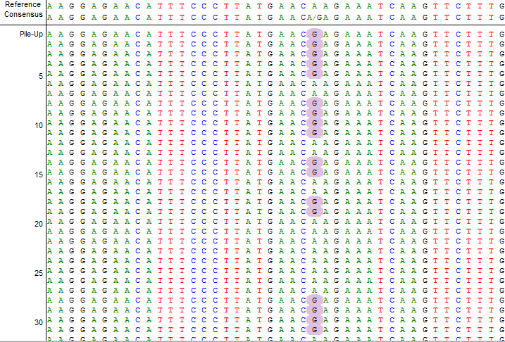
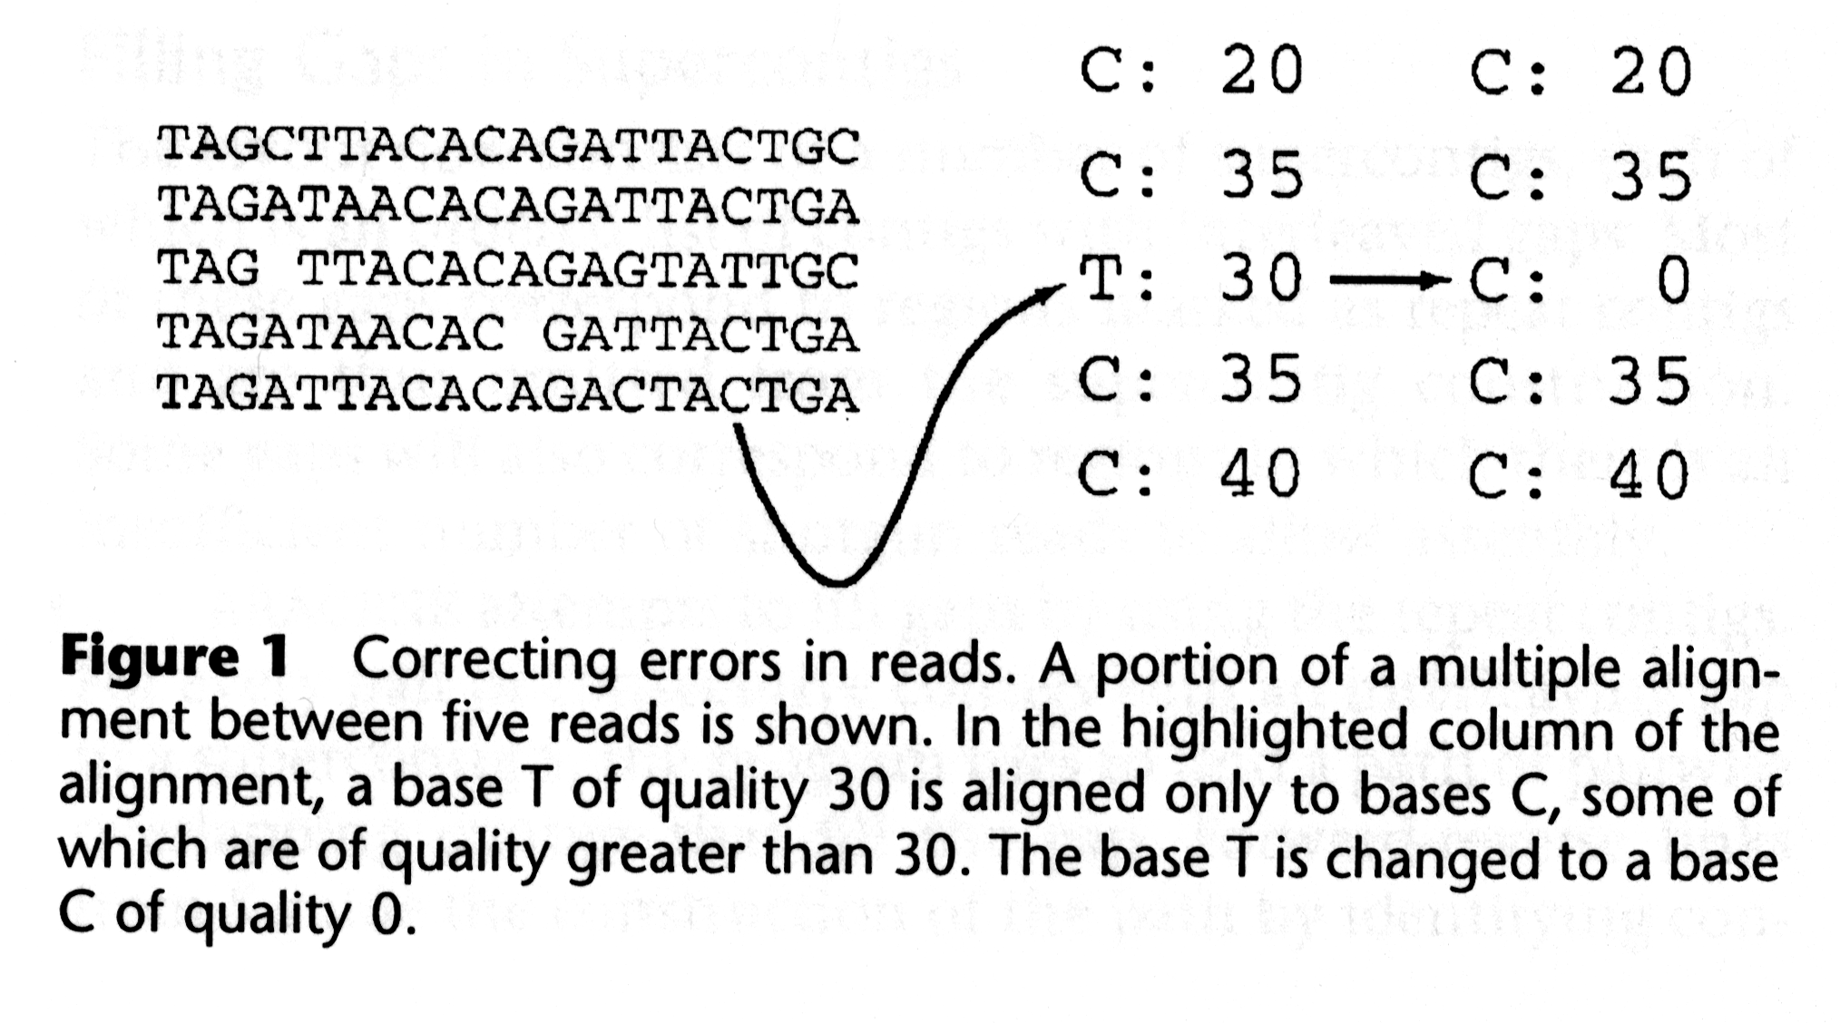
Detecting single nucleotide polymorphisms (SNPs): signal vs noise
Likely noise (genotyping artifact)
Likely signal (real SNP)

Slide 26
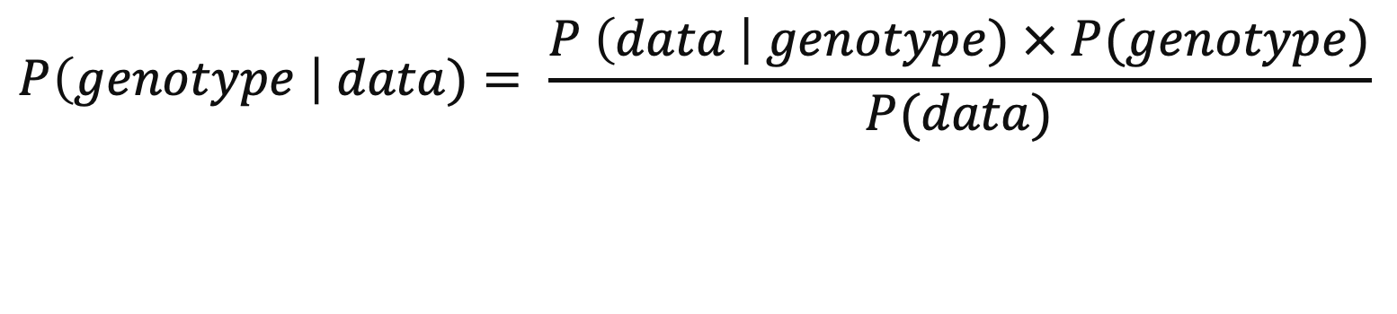
Detecting single nucleotide polymorphisms (SNPs): signal vs noise
Considerations when calling SNPs:
Number of reads supporting allele (depth)
Base quality of allele
Mapping quality of read
Comparison against known SNPs/haplotypes
Posterior Probability
Prior
Likelihood
$$P\left(genotype \right| data)= \frac{P \left(data \right| genotype) × P(genotype)}{P(data)}$$
Evidence

Slide 27
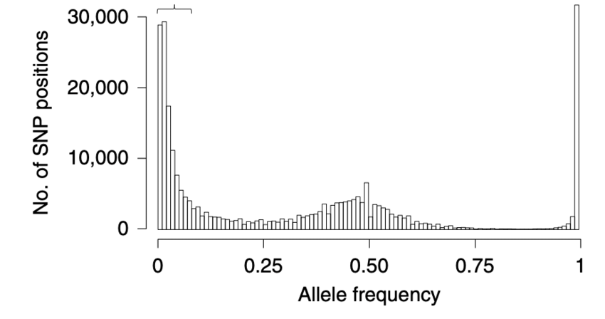
Detecting single nucleotide polymorphisms (SNPs): genotypes
Genotype | % of reads
AA | 100% A’s
AG | 50% A’s and 50% G’s
GG | 100% G’s

Slide 28
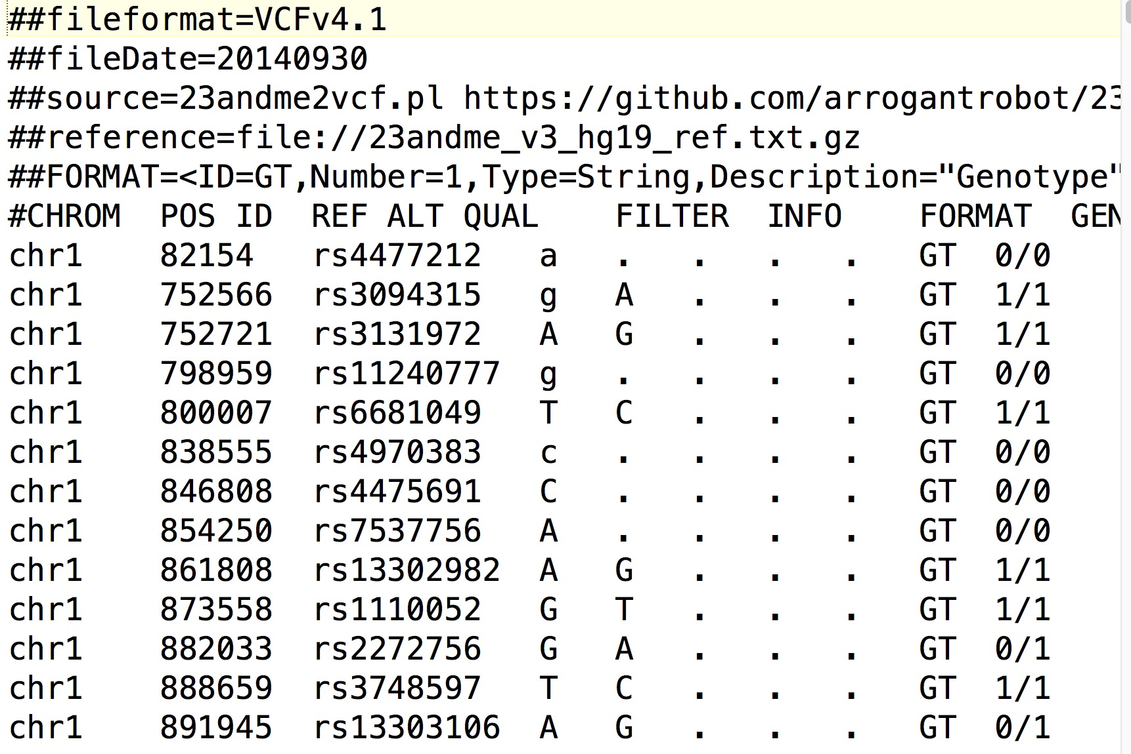
DNA Alignment Pipeline
VCF file
This gives us sites in the genome where an individual differs from the reference genome.
We want to find mutations that are specifically found in the tumour that can predict response to treatment.

Slide 29
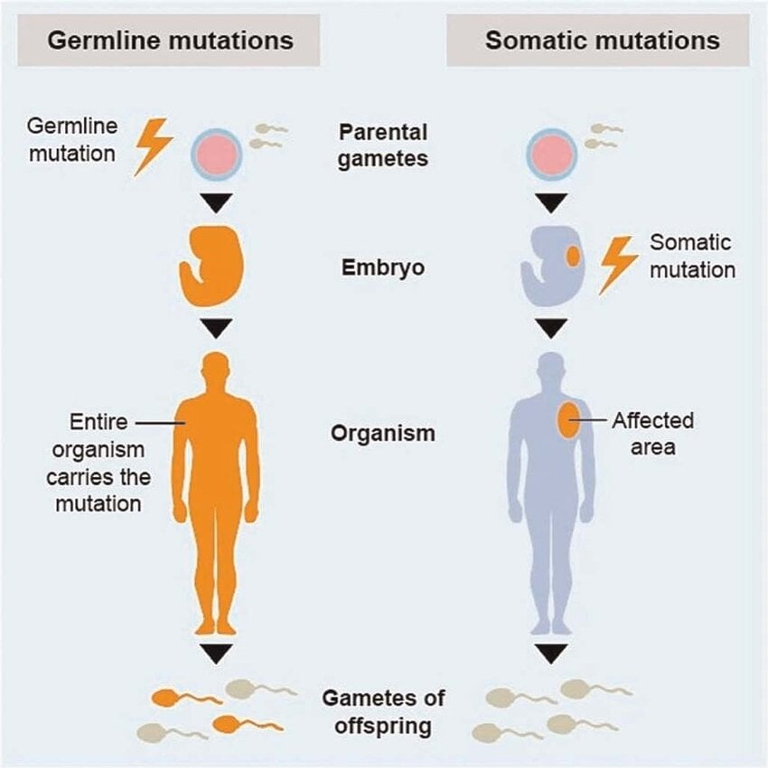
Germline vs Somatic
How do we differentiate between germline variants and somatic mutations?

Slide 30
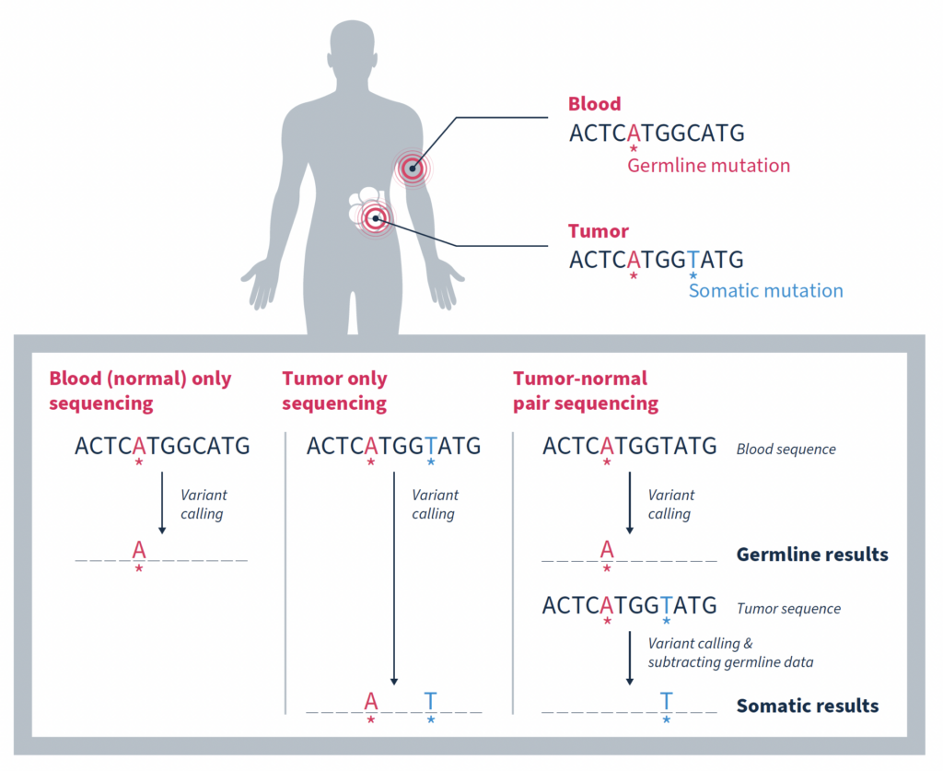
Detecting somatic mutations with tumour and matched normal sequencing

Slide 31
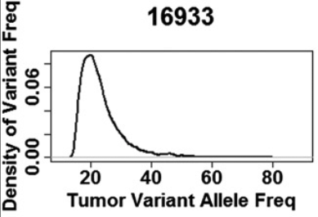
Allele frequencies of somatic vs germline variants
Germline variant allele frequencies
Somatic mutation allele frequencies
Genotype | % of reads
AA | 100% A’s
AG | 50% A’s and 50% G’s
GG | 100% G’s
Genotype | % of reads
AA | 100% A’s
AG | <50% G
GG | 100% G’s

Slide 32
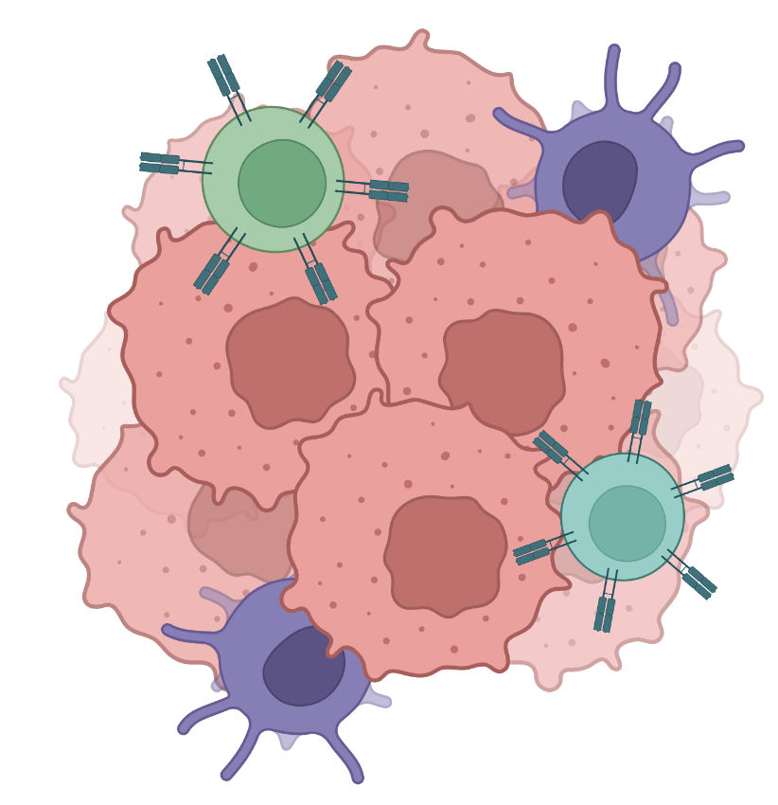
Allele frequencies of somatic vs germline variants
Somatic mutation allele frequencies
Non-tumour cells in sample decreases the allele frequency
Genotype | % of reads
AA | 100% A’s
AG | <50% G
GG | 100% G’s

Slide 33
Small insertions/deletions (INDEL)
Definition: Addition or removal of a small number of base pairs (1-50 bp)
Reference Genome
A T C G C A G …
Example Sequence 1
(insertion)
A T C G C A A G …
Example Sequence 2
(deletion)
A T C G C G …
Harder to reliably detect than SNVs

Slide 34
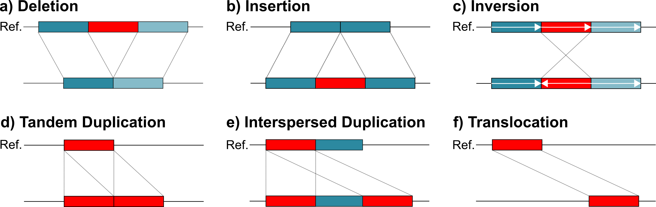
Structural Variants (SVs)
Definition: Large genomic changes (>50 bp to megabases)
Deletions
Duplications
Inversion
Translocations
Ref.
Ex.
Red segment of DNA has been deleted
A second copy of the red segment has been gained
The red segment has been inverted
The red segment has translocated from one region of the genome to another
Hardest variant type to reliable detect

Slide 35
Types of genetic variation
Types of genetic variation:
Size Scale
Single base pair
Single nucleotide variants (SNV)
Small insertions/deletions (INDEL)
Structural alterations (SV)
Megabases

Slide 36
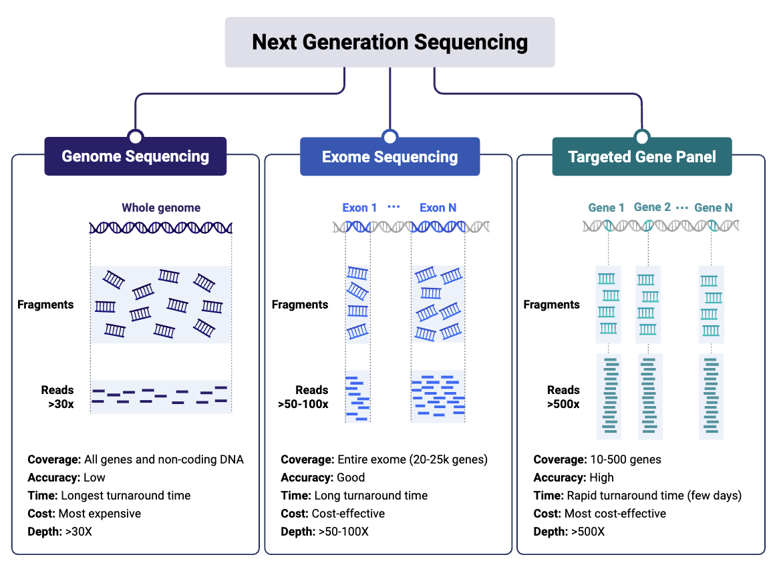
Types of sequencing
Biorender

Slide 37
The Human Genome: a single “average” reference
The Human Genome Project (1990-2003)
Original sequence covered 90% and came from 20 volunteers
GRCh38 (2013)
Covered up to 92% of total genome
  Gaps primarily in centromeres & telomeres
Telomere-to-telomere (T2T) (2022)
T2T Consortium released first gapless human genome
Notes:
This is in part due on over reliance on the human reference during genomics analysis. In the late 1990s, the first human genome was constructed 70% of which was derived from a single individual of blended ancestry. Since, then the human reference genome has undergone multiple updates since then but these updates have largely focused on filling in gaps in the genome. The sequence of the GRCh38 is still 70% derived from a single donor of blended ancestry.

Slide 38
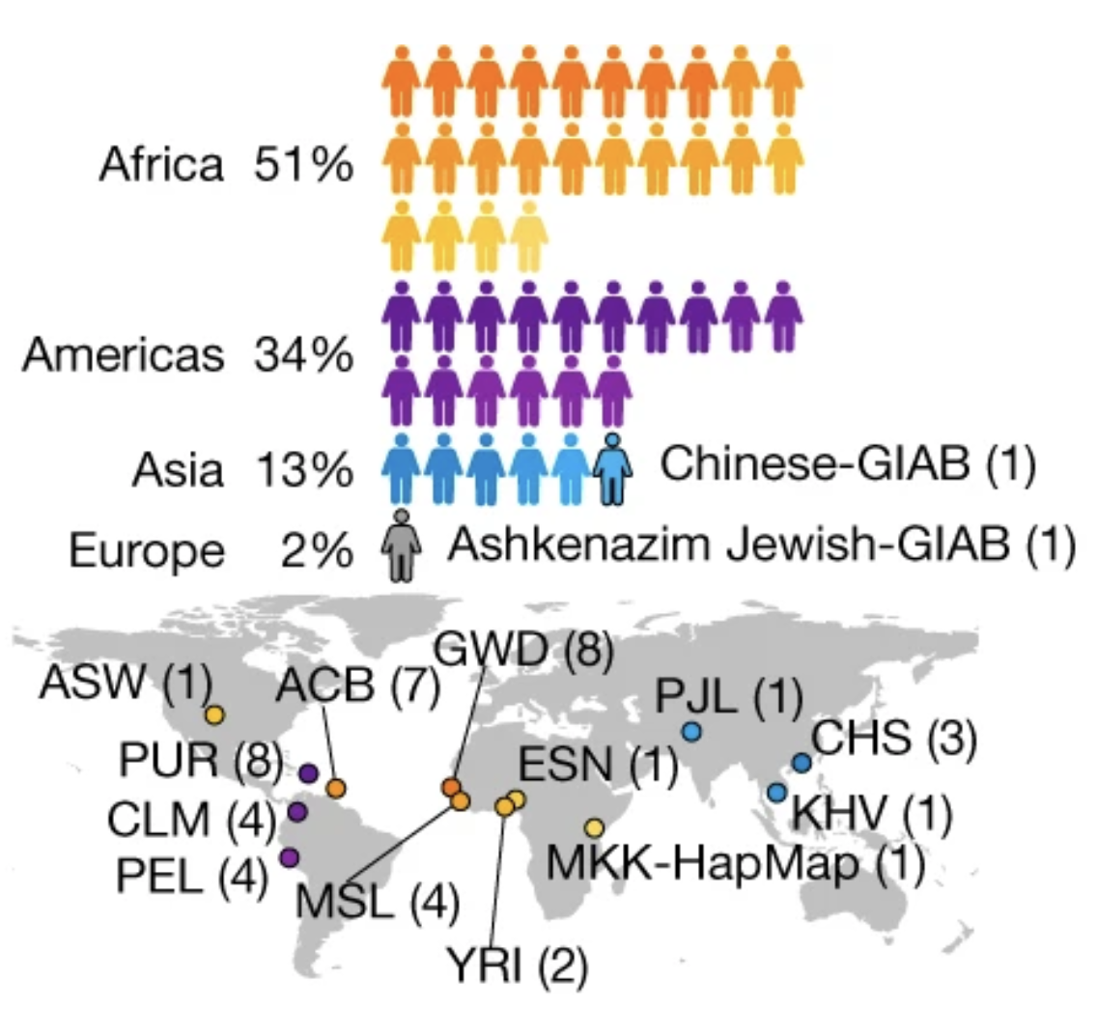
A new “draft” reference genome: The pangenome
47 individuals sequenced with:
Pacific Biosciences (PacBio) high-fidelity (HiFi)
Oxford Nanopore Technologies (ONT) long-read sequencing
Bionano optical maps
High-coverage Hi-C Illumina short-read sequencing
Liao et al. Nature 2023

Slide 39
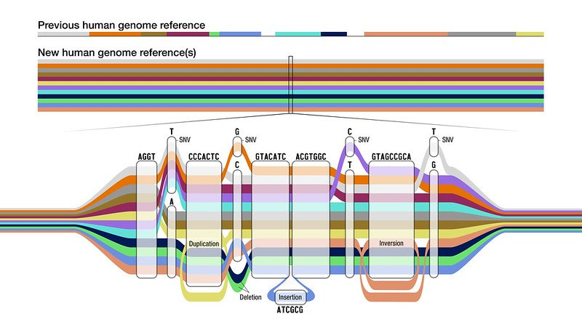
A new “draft” reference genome: The pangenome
Improvement to germline variation detection:
34% increase in single nucleotide variants
104% increase in structural variants
Liao et al. Nature 2023

Slide 40
A new “draft” reference genome: The pangenome
Improvement to germline variation detection:
34% increase in single nucleotide variants
104% increase in structural variants
Liao et al. Nature 2023

Slide 41
A new “draft” reference genome: The pangenome
Improvement to germline variation detection:
34% increase in single nucleotide variants
104% increase in structural variants
Liao et al. Nature 2023

Slide 42
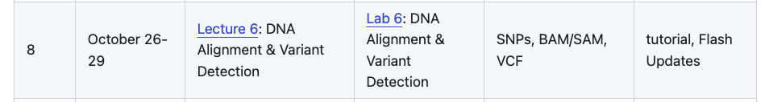
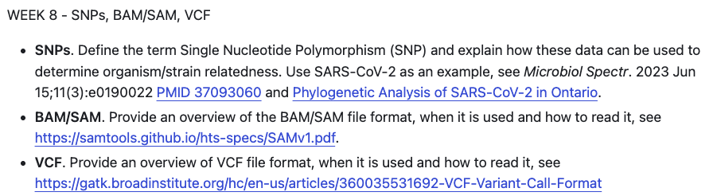
This week …

